Slide 1
Prediction of hospital readmissions for patients with diabetes
Neeraj Kumar Reddy Panta
Ruchi Dilip Kukde

Slide 2
Hypothesis testing
Focus: Female and Male patients readmitted within 30 days in age groups:
30-40 years
40-50 years
50-60 years
60-70 years
70-80 years
G1: Female patients
G2: Male patients

Slide 3
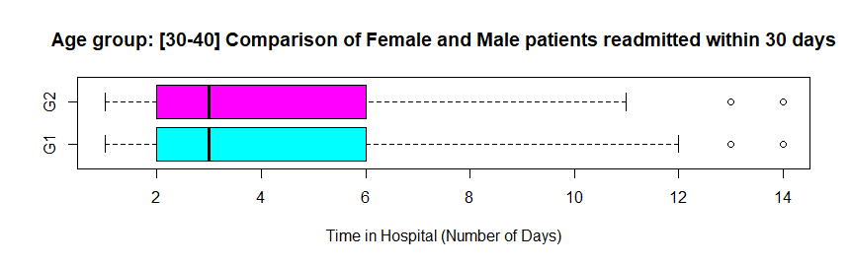
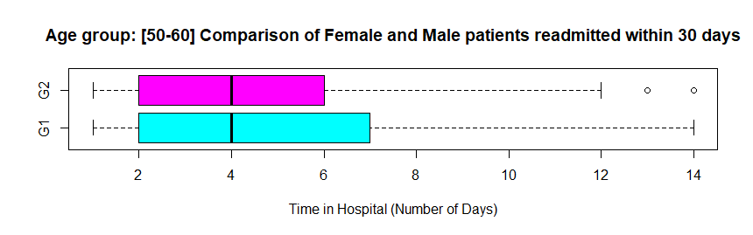

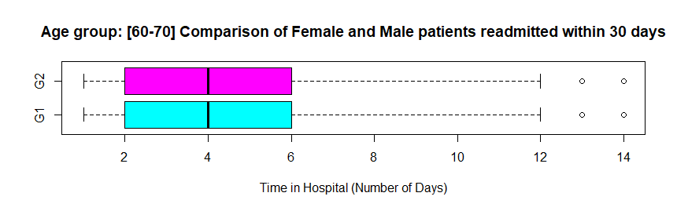
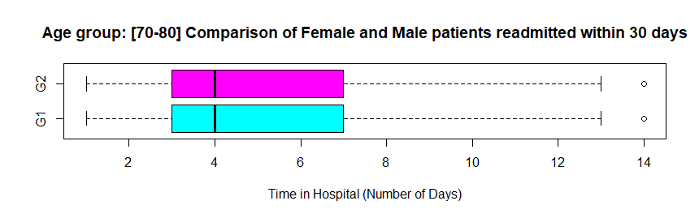
Visualization: Boxplots

Slide 4
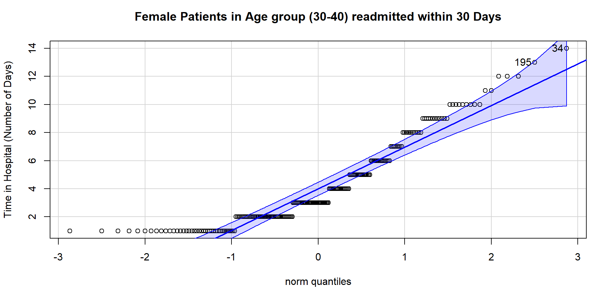
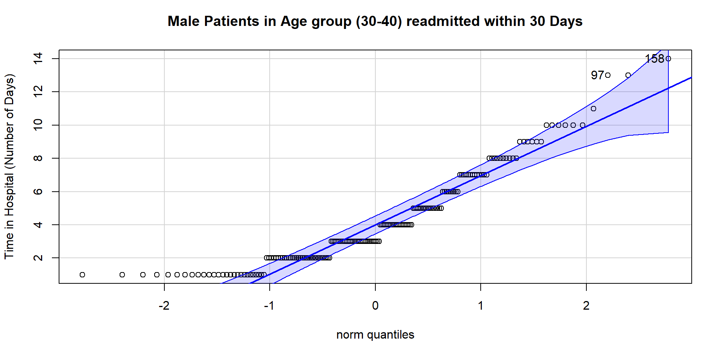

Slide 5
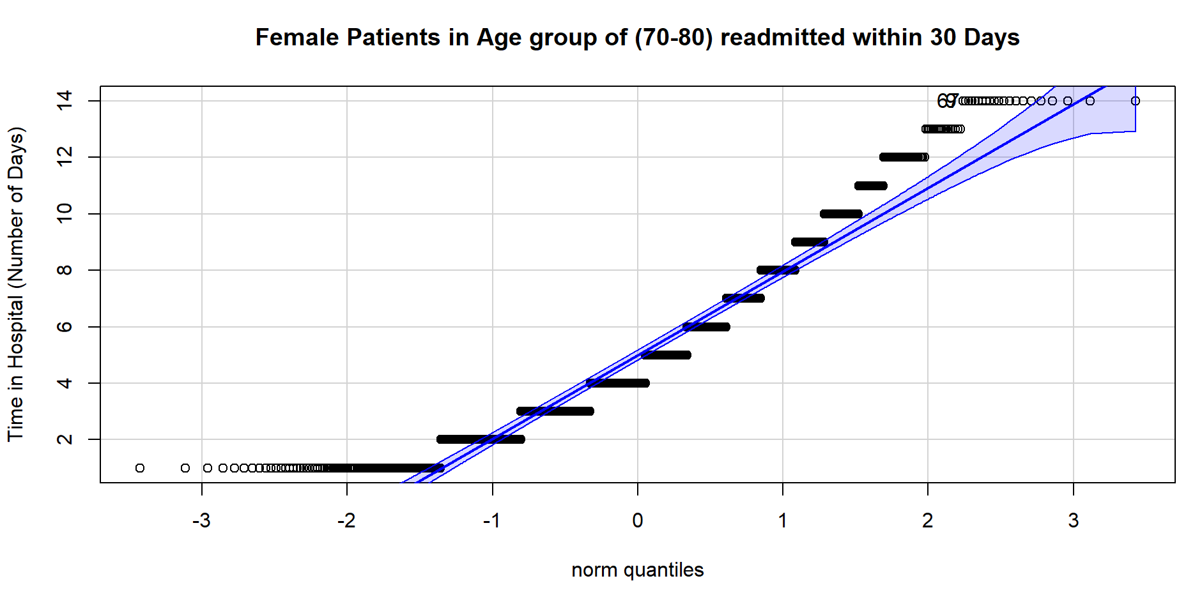
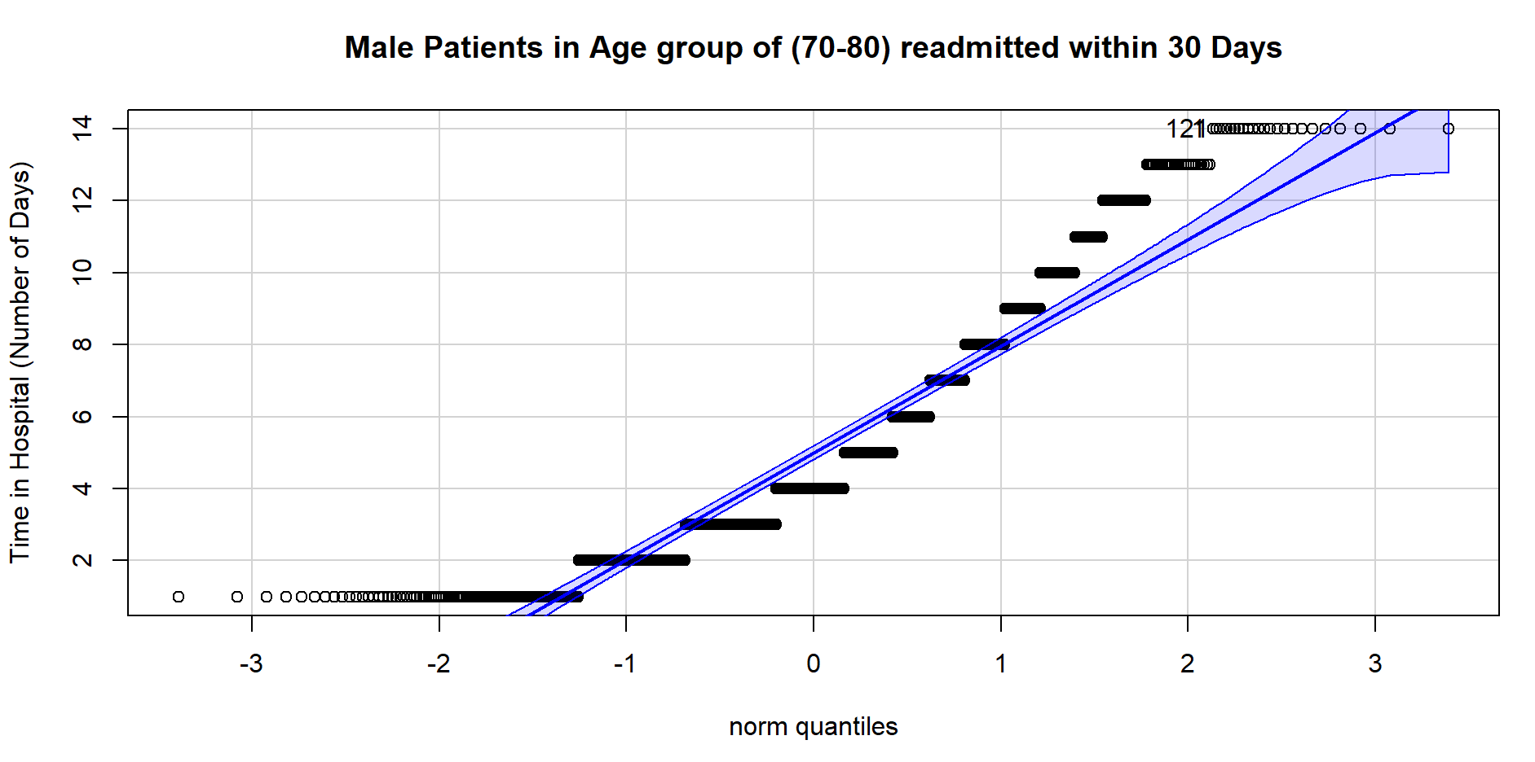

Slide 6
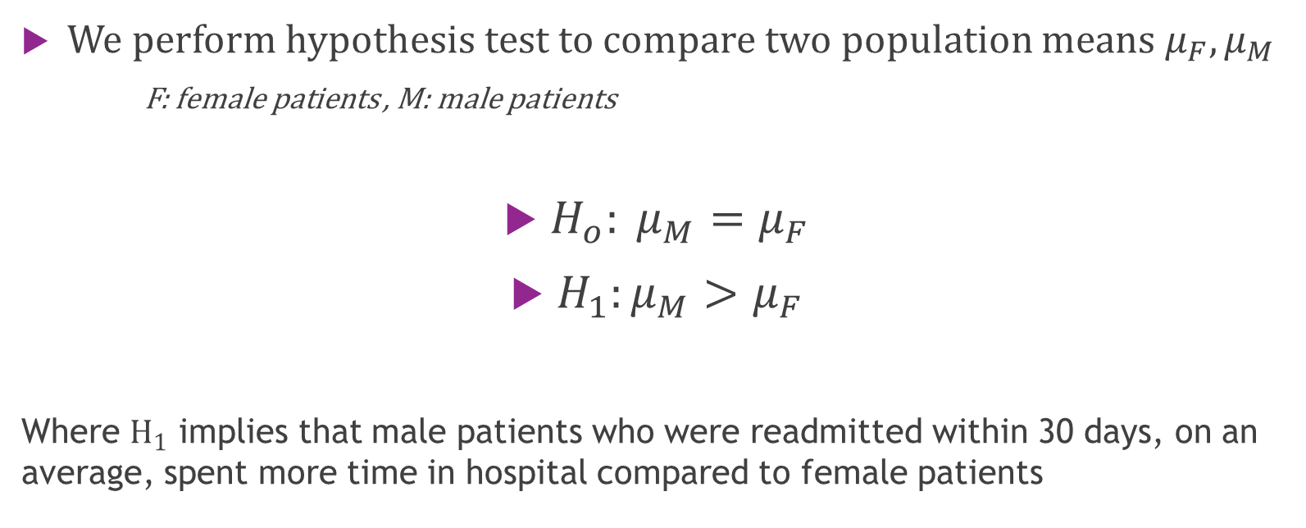
Hypothesis statement
We perform hypothesis test to compare two population means $μ_{F}, μ_{M}$
F: female patients , M: male patients
$H_{o}: μ_{M}=μ_{F}$
$H_{1}:μ_{M}>μ_{F}$
Where $H_{1}$ implies that male patients who were readmitted within 30 days, on an average, spent more time in hospital compared to female patients

Slide 7
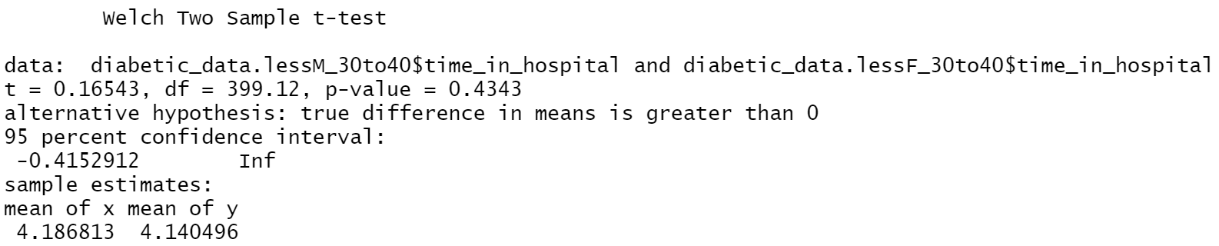

Test of Significance Group 30-40 years
For the test, $α=0.05$
Observations:
p-value= 0.4343
95% confidence interval contains ‘0’

Slide 8
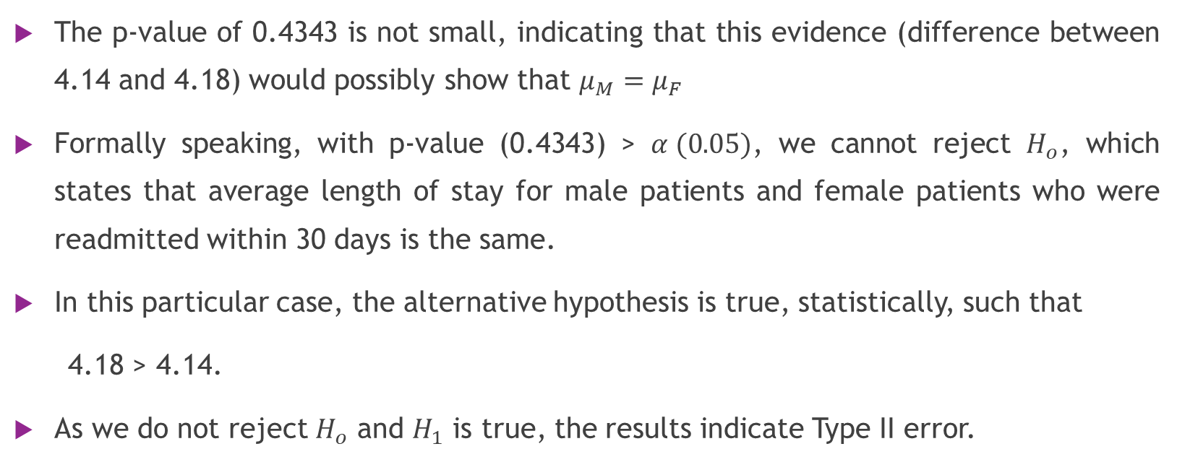
Results
The p-value of 0.4343 is not small, indicating that this evidence (difference between 4.14 and 4.18) would possibly show that $μ_{M}=μ_{F}$
Formally speaking, with p-value (0.4343) > $α (0.05)$, we cannot reject $H_{o}$, which states that average length of stay for male patients and female patients who were readmitted within 30 days is the same.
In this particular case, the alternative hypothesis is true, statistically, such that
4.18 > 4.14.
As we do not reject $H_{o}$ and $H_{1}$ is true, the results indicate Type II error.

Slide 9
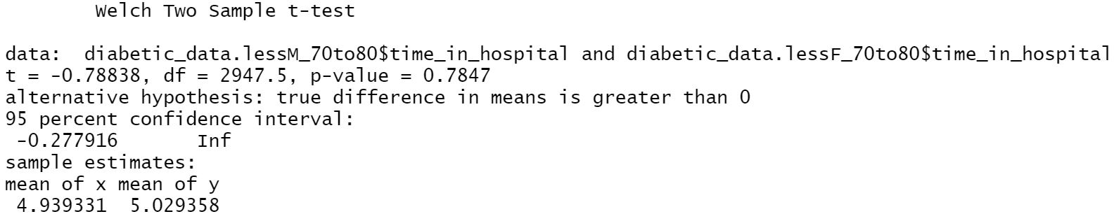

Test of Significance Group 70-80 years
For the test, $α=0.05$
Observations:
p-value= 0.7847
95% confidence interval contains ‘0’

Slide 10
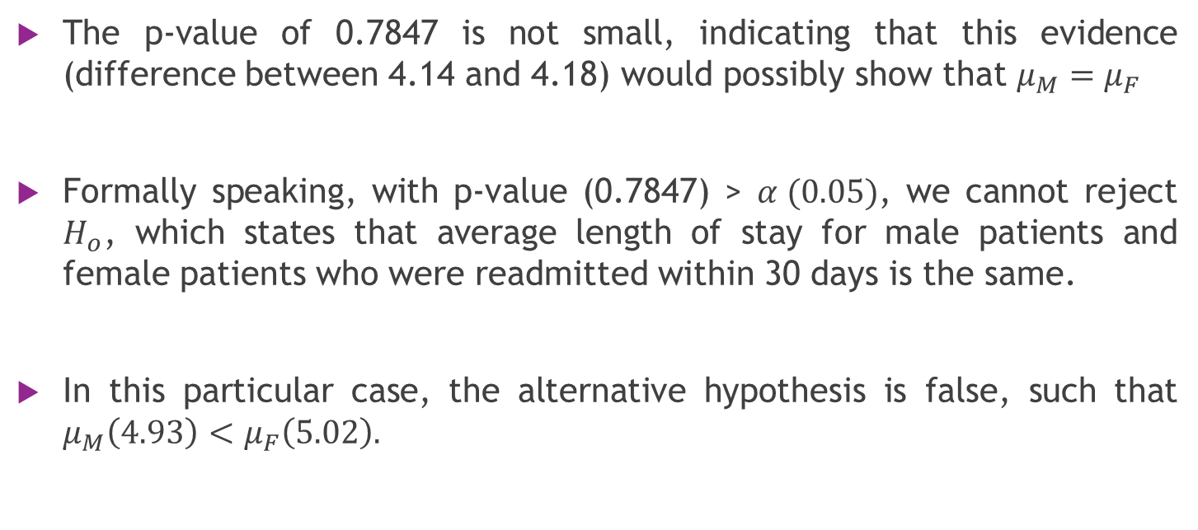
Results
The p-value of 0.7847 is not small, indicating that this evidence (difference between 4.14 and 4.18) would possibly show that $μ_{M}=μ_{F}$
Formally speaking, with p-value (0.7847) > $α (0.05)$, we cannot reject $H_{o}$, which states that average length of stay for male patients and female patients who were readmitted within 30 days is the same.
In this particular case, the alternative hypothesis is false, such that $μ_{M}\left(4.93\right)<μ_{F}\left(5.02\right).$

Slide 11
Practical Significance
Length of stay in hospital is reported as number of days (integers) in the dataset.
Statistically, average length of stay of 4.14 and 4.18 days for 30-40 years group and 4.93 and 5.02 days for 70-80 years group are different values.
Practically speaking, it is implied that for age group 30-40 years the average length of stay would be 4 days and for age group 70-80 years, it is 5 days.
According to context of the problem, the null hypothesis cannot be rejected as evidence and assumption are not that different.

Slide 12
Thank you

